Slide 1
Live cell biosensor assay

Slide 2
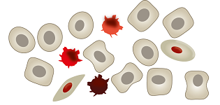
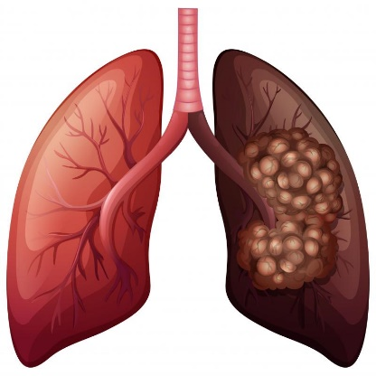
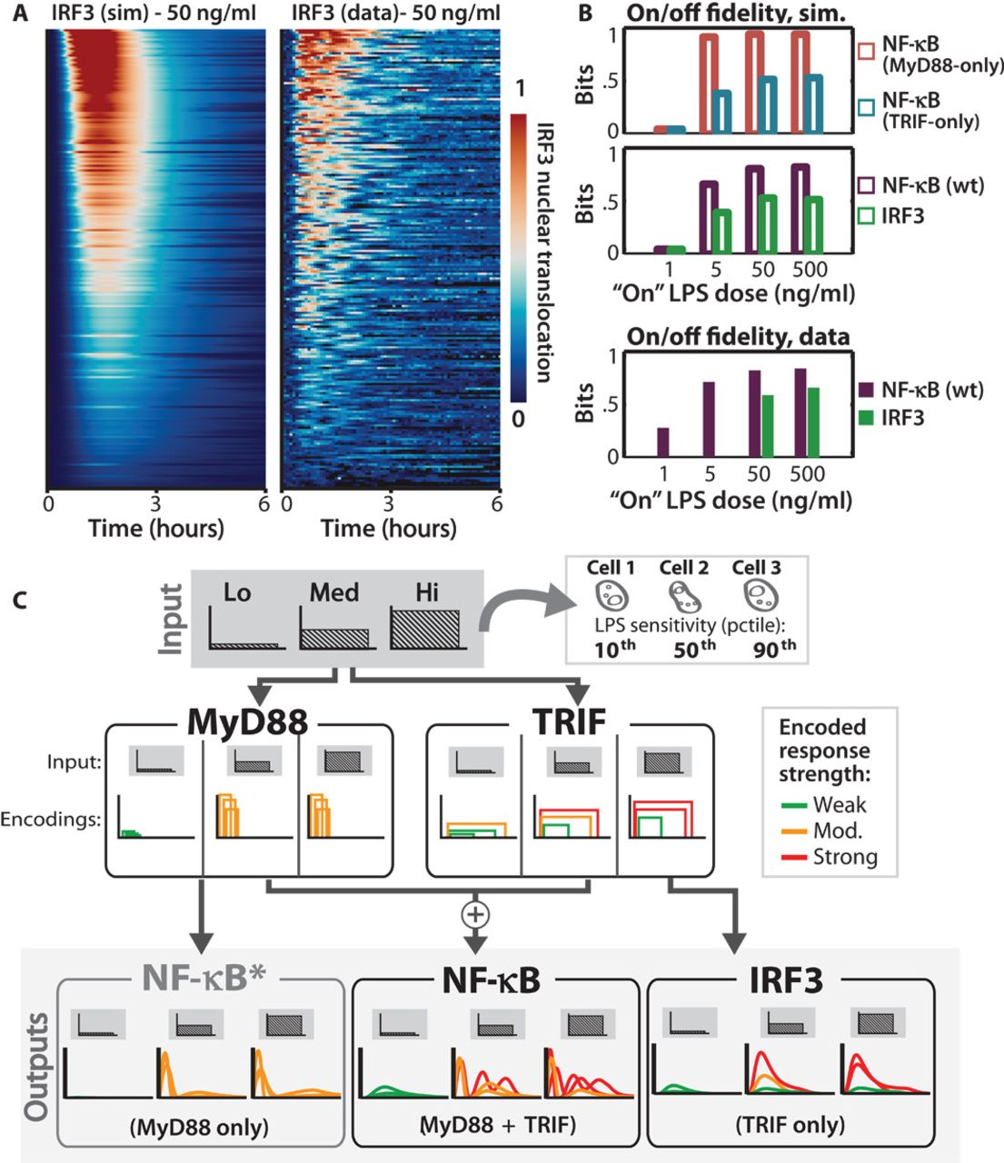
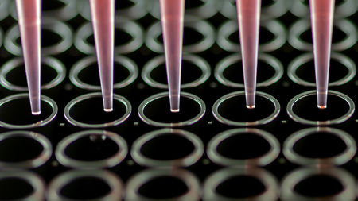
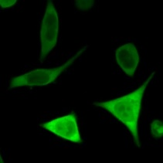
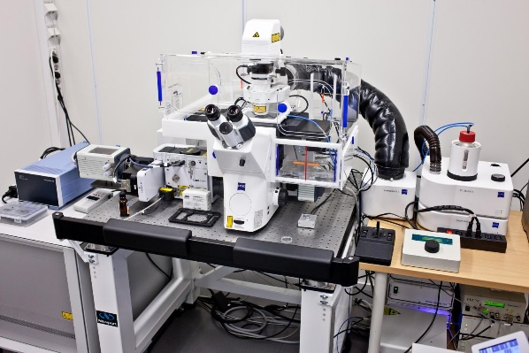
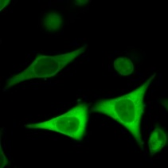
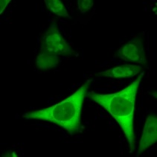
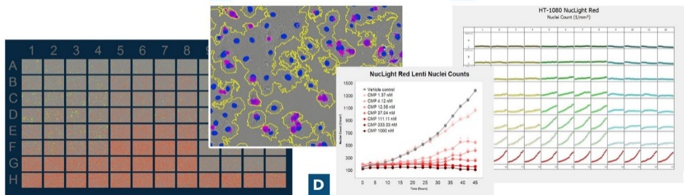
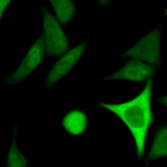
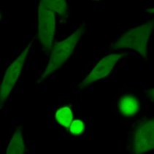
Overview
Tumor biopsy / resected tumor
Viral delivery of fluorescent reporters
fast functionality readout
Tumor cell dissociation
minimize cytotoxicity
Tumor functionality-informed precision medicine
48-72h elapsed time
Single cell- resolution cell signaling and drug response
Selected therapies
Automatic cell image analysis
Automatic time-lapse imaging
Notes:
This is the overview of our in vitro platform. After we acquired tumor samples from patients, we will dissociate part of the tumor into single cell suspension while retaining cell viability. These cells will be plated on 96 well chamber where we deliver fluorescent bioreporters using lentivirus. When the transduced cells are ready for assay, we will treat these cells with various selected treatments and then immediately undergo automatic time-lapse imaging using confocal spinning disk microscope. To further increase the throughput of our platform and avoid human bias during data processing, we will analysis our images using customized program. Our goal is to acquire cell signaling data within 48h after tumor removal to inform precision medicine and predict treatment response.

Slide 3
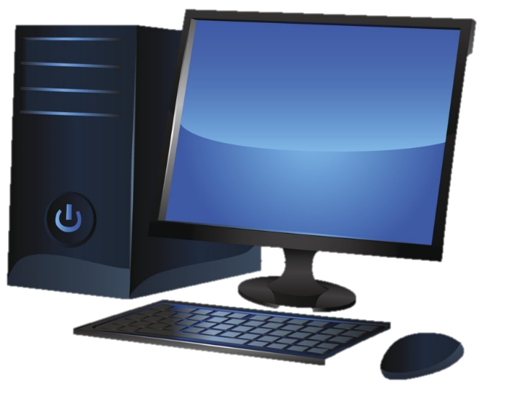
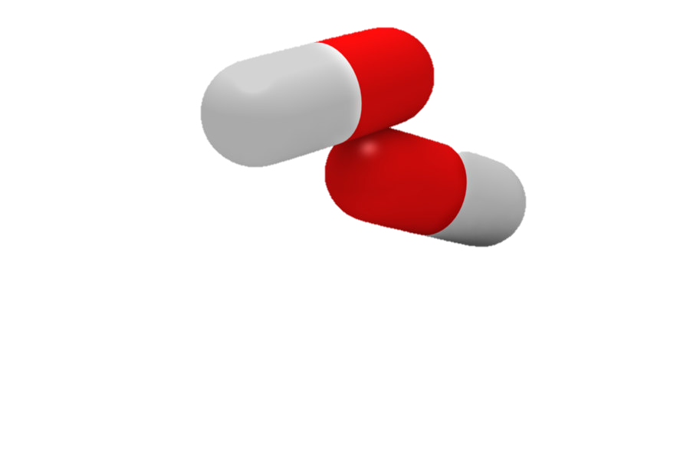
Function genomics + biosensor imaging
Gene A
Gene B
Gene C
…
150. Gene X
Breast cancer patient database
Notes:
Look for co-factors that drives treatment resistance, we will examine the large scale patient database to look for genes that are associated with poor survival
We will further prioritize these genes using bioinformatics tools to get a high confidence gene list for further study.
Build a resistance gene library and study them using the pharmacodynamics imaging system similar to what I described before.

Slide 4
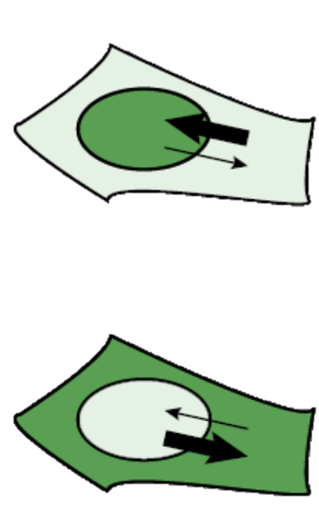
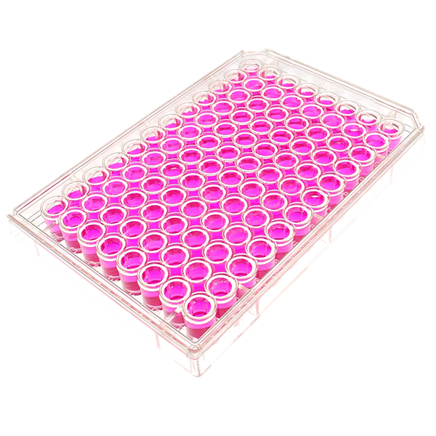
Pharmacodynamics imaging
Translocation reporter
Reporter 1
nucleus
Reporter 2
Active
Inactive
Notes:
I built this pharmacodynamics imaging system aiming to track drug response. This system has two key components – a collection of translocation reporters which shuffle between cytoplasm and nucleus based on drug activity, and a fully automated cell imaging system that can continuously scan the entire 96 well plate for days. Each well here contain a unique cell samples, they can be cells expressing different HER2 mutations or resistant gene drivers, or they can be cells under different treatments.
To facilitate data analysis, we also developed a customized algorithm to transform terabytes of images into analyzable figures for further interpretation.

Slide 5
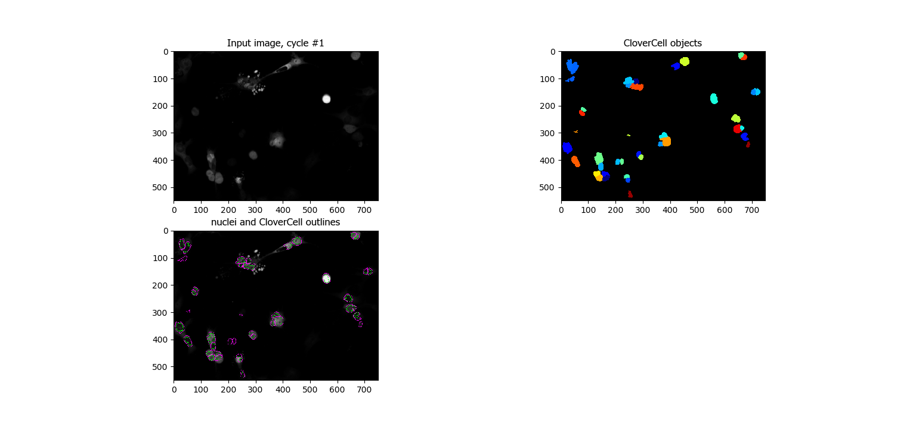
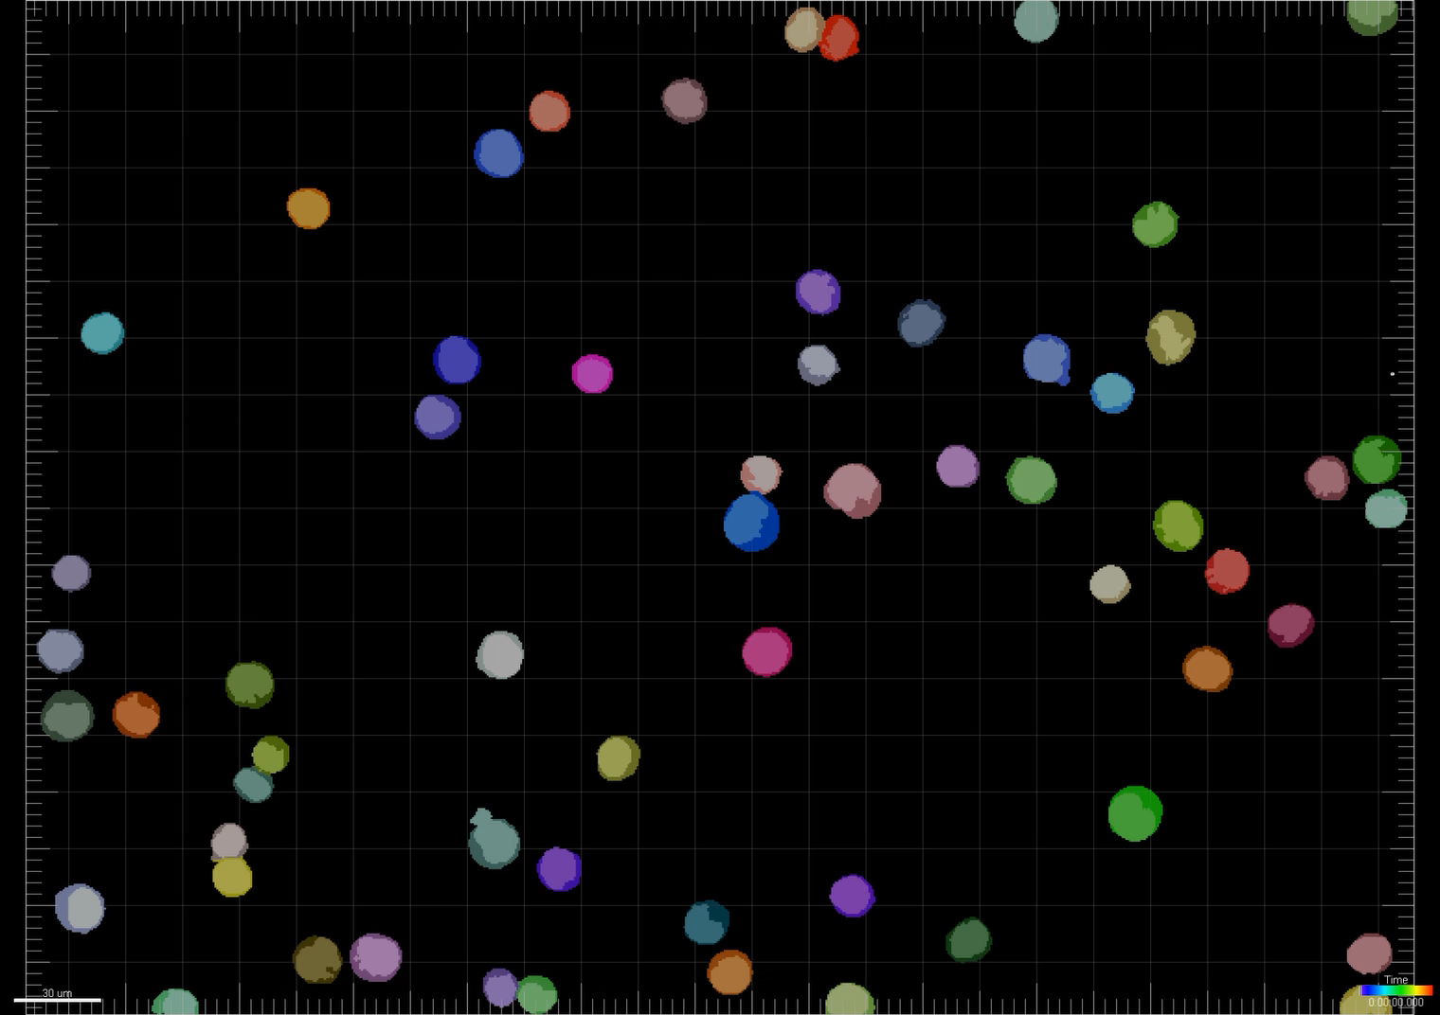
Image analysis pipeline
ilastik
Cell Profiler
FIJI ImageJ
Imaris
Nucleus classification
(machine learning)
Cytoplasm classification
(dilation with fixed pixel)
Reconstruct hypserstacks with metadata
Cell tracking & data export
Notes:
I built this pharmacodynamics imaging system aiming to track drug response. This system has two key components – a collection of translocation reporters which shuffle between cytoplasm and nucleus based on drug activity, and a fully automated cell imaging system that can continuously scan the entire 96 well plate for days. Each well here contain a unique cell samples, they can be cells expressing different HER2 mutations or resistant gene drivers, or they can be cells under different treatments.
To facilitate data analysis, we also developed a customized algorithm to transform terabytes of images into analyzable figures for further interpretation.

Slide 6
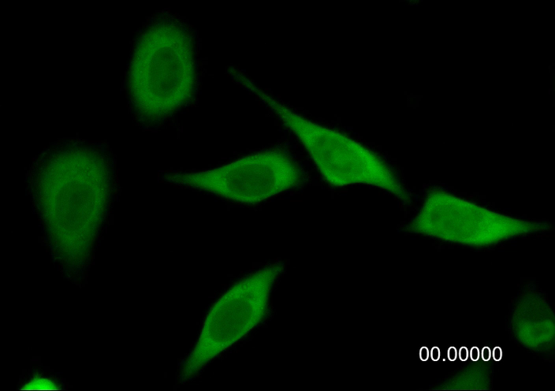
How to quantify reporter activity?
R$eporter Activity \left(RA\right)=\frac{{Mean intensity}_{compartment (active)}}{{Mean intensity}_{compartment (inactive)}}$
$$Reporter Activity Score=\frac{Reporter Activity t−Reporter Activity min}{Reporter Activity\max{− Reporter Activity min}}$$
Notes:
I built this pharmacodynamics imaging system aiming to track drug response. This system has two key components – a collection of translocation reporters which shuffle between cytoplasm and nucleus based on drug activity, and a fully automated cell imaging system that can continuously scan the entire 96 well plate for days. Each well here contain a unique cell samples, they can be cells expressing different HER2 mutations or resistant gene drivers, or they can be cells under different treatments.
To facilitate data analysis, we also developed a customized algorithm to transform terabytes of images into analyzable figures for further interpretation.

Slide 7
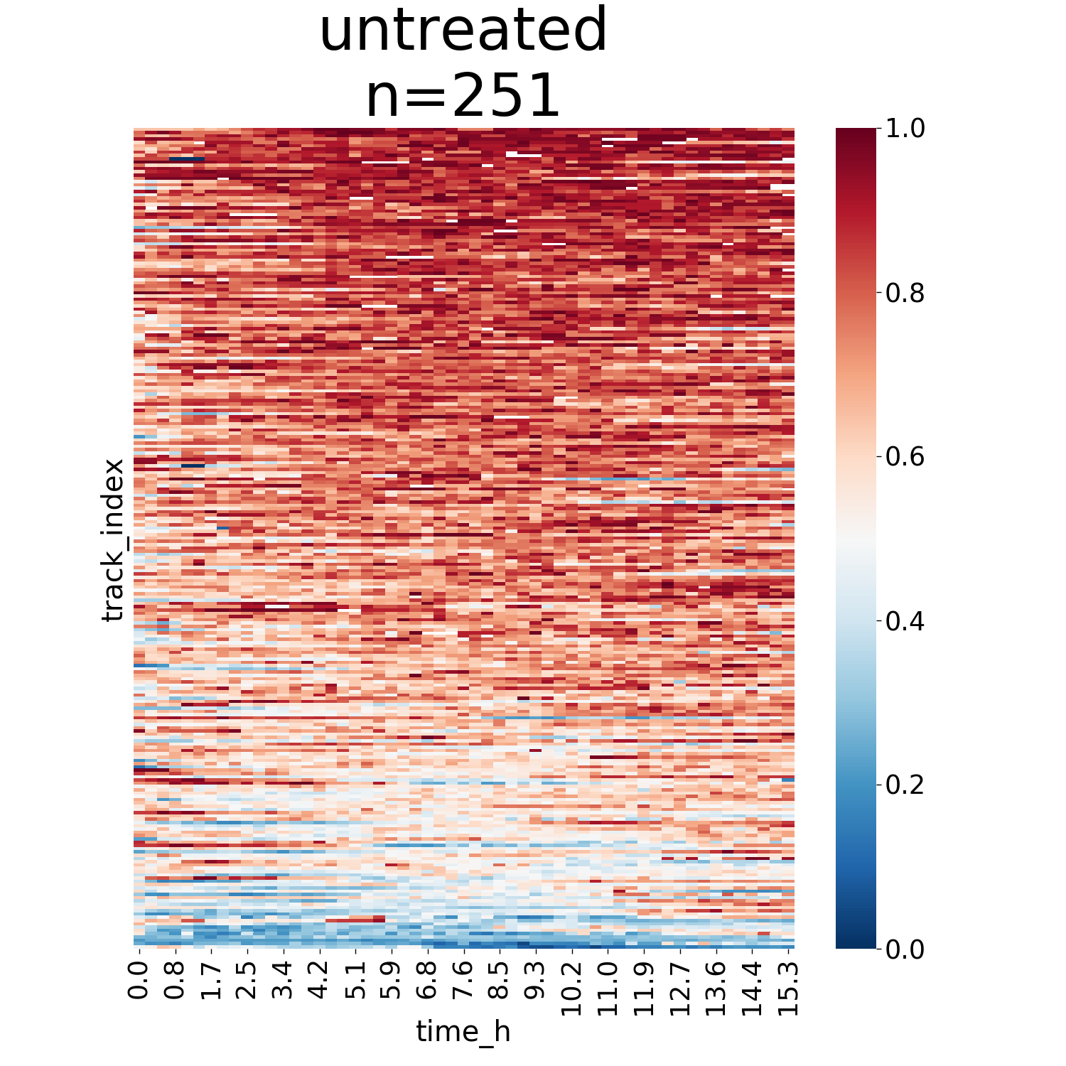
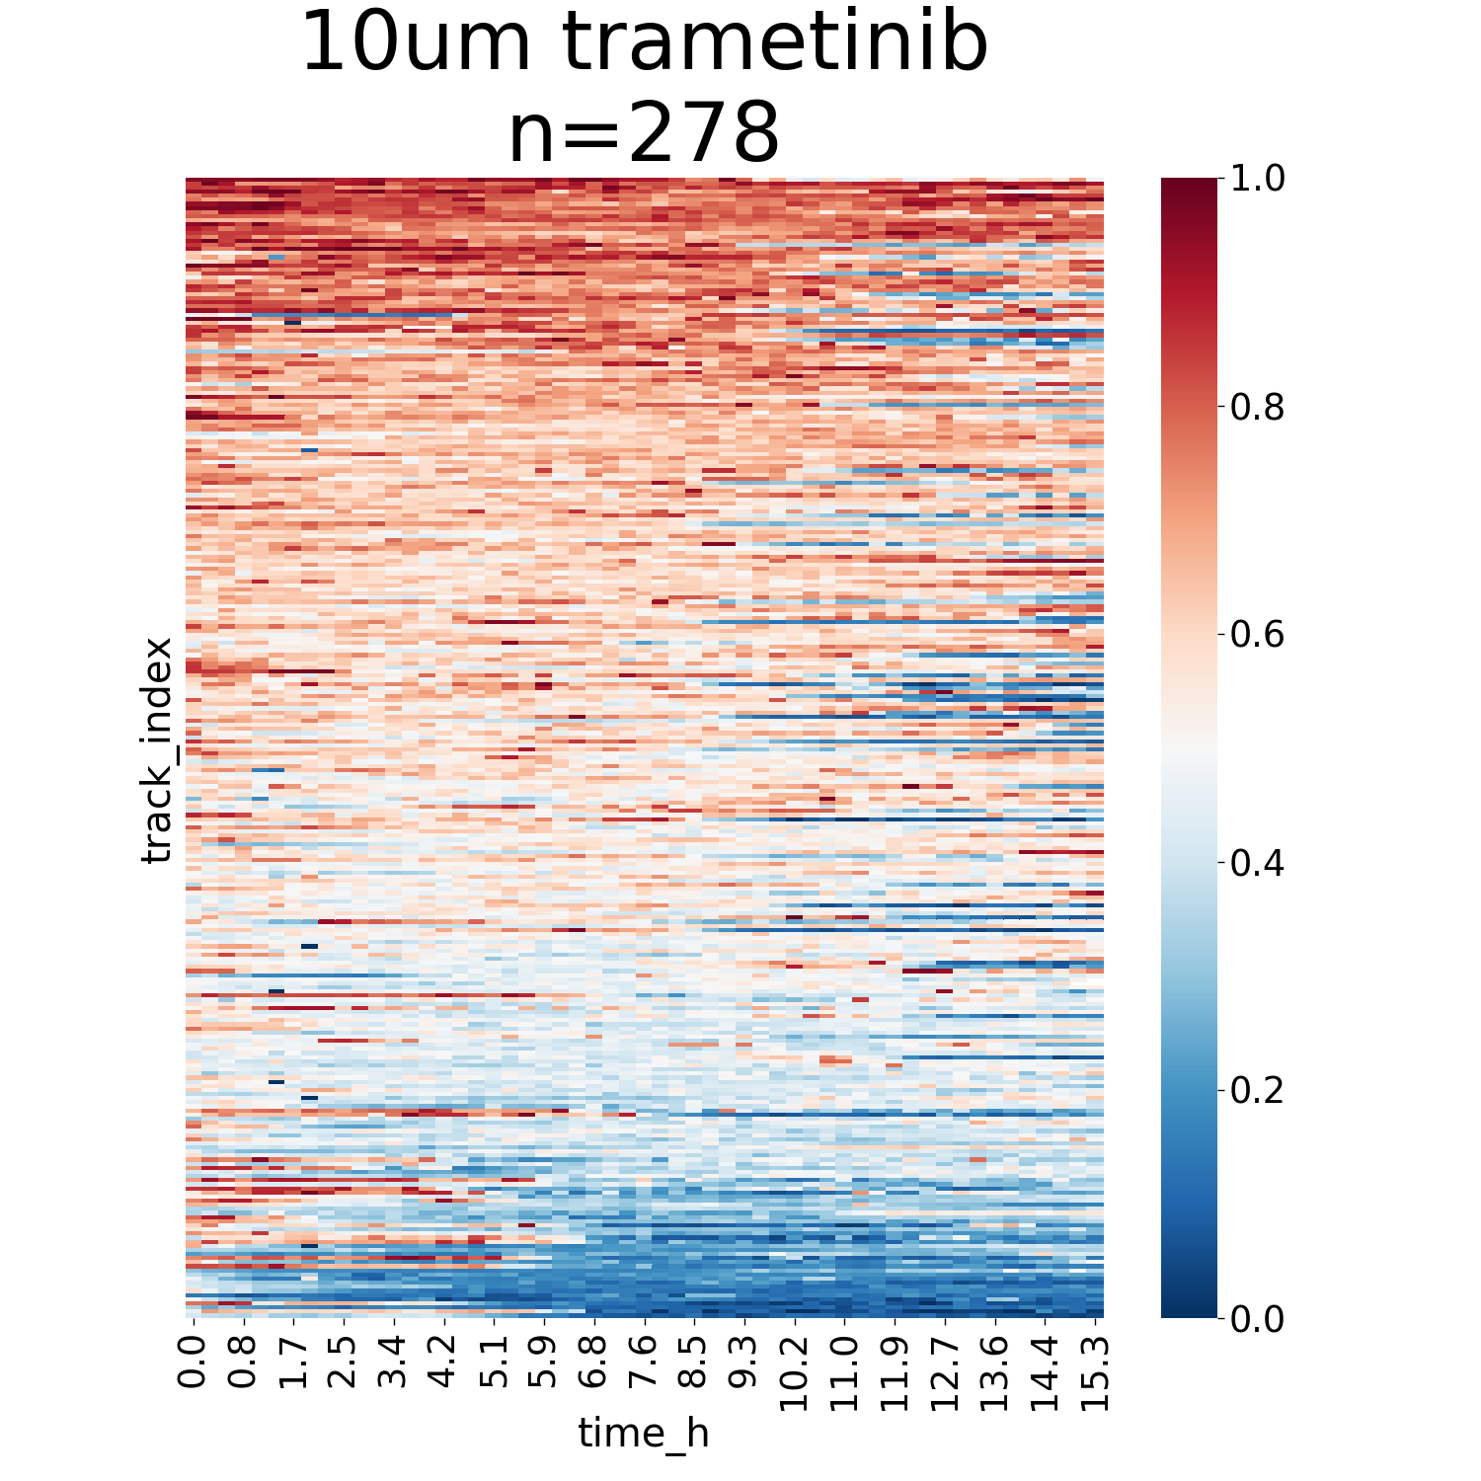
Imaging analysis pipeline
1. CombineTools_abs
Single cell
Average
Notes:
I built this pharmacodynamics imaging system aiming to track drug response. This system has two key components – a collection of translocation reporters which shuffle between cytoplasm and nucleus based on drug activity, and a fully automated cell imaging system that can continuously scan the entire 96 well plate for days. Each well here contain a unique cell samples, they can be cells expressing different HER2 mutations or resistant gene drivers, or they can be cells under different treatments.
To facilitate data analysis, we also developed a customized algorithm to transform terabytes of images into analyzable figures for further interpretation.

Slide 8
Imaging analysis pipeline
2. CombineTools_sort_by_start
Notes:
I built this pharmacodynamics imaging system aiming to track drug response. This system has two key components – a collection of translocation reporters which shuffle between cytoplasm and nucleus based on drug activity, and a fully automated cell imaging system that can continuously scan the entire 96 well plate for days. Each well here contain a unique cell samples, they can be cells expressing different HER2 mutations or resistant gene drivers, or they can be cells under different treatments.
To facilitate data analysis, we also developed a customized algorithm to transform terabytes of images into analyzable figures for further interpretation.

Slide 9
Imaging analysis pipeline
3. CombineTools_sort_by_channel
Sort by:
DNA damage
Notes:
I built this pharmacodynamics imaging system aiming to track drug response. This system has two key components – a collection of translocation reporters which shuffle between cytoplasm and nucleus based on drug activity, and a fully automated cell imaging system that can continuously scan the entire 96 well plate for days. Each well here contain a unique cell samples, they can be cells expressing different HER2 mutations or resistant gene drivers, or they can be cells under different treatments.
To facilitate data analysis, we also developed a customized algorithm to transform terabytes of images into analyzable figures for further interpretation.

Slide 10
Pathway coordination – Kmeans clustering
NOT GOOD!!!
Notes:
I built this pharmacodynamics imaging system aiming to track drug response. This system has two key components – a collection of translocation reporters which shuffle between cytoplasm and nucleus based on drug activity, and a fully automated cell imaging system that can continuously scan the entire 96 well plate for days. Each well here contain a unique cell samples, they can be cells expressing different HER2 mutations or resistant gene drivers, or they can be cells under different treatments.
To facilitate data analysis, we also developed a customized algorithm to transform terabytes of images into analyzable figures for further interpretation.

Slide 11
Pathway coordination – TSNE
NOT GOOD!!!
Notes:
I built this pharmacodynamics imaging system aiming to track drug response. This system has two key components – a collection of translocation reporters which shuffle between cytoplasm and nucleus based on drug activity, and a fully automated cell imaging system that can continuously scan the entire 96 well plate for days. Each well here contain a unique cell samples, they can be cells expressing different HER2 mutations or resistant gene drivers, or they can be cells under different treatments.
To facilitate data analysis, we also developed a customized algorithm to transform terabytes of images into analyzable figures for further interpretation.

Slide 12
Pathway coordination – Hierarchical clustering
Notes:
I built this pharmacodynamics imaging system aiming to track drug response. This system has two key components – a collection of translocation reporters which shuffle between cytoplasm and nucleus based on drug activity, and a fully automated cell imaging system that can continuously scan the entire 96 well plate for days. Each well here contain a unique cell samples, they can be cells expressing different HER2 mutations or resistant gene drivers, or they can be cells under different treatments.
To facilitate data analysis, we also developed a customized algorithm to transform terabytes of images into analyzable figures for further interpretation.

Slide 13
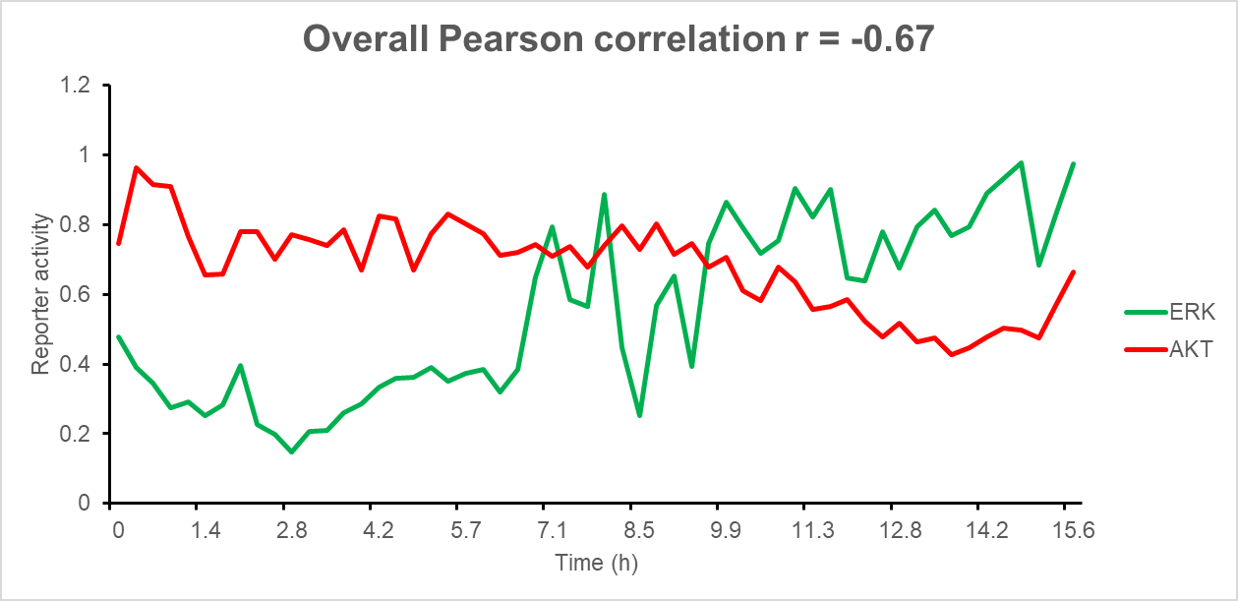
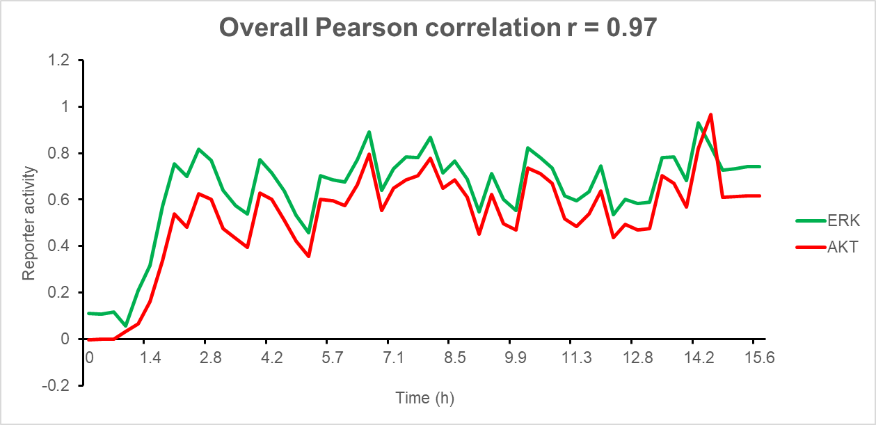
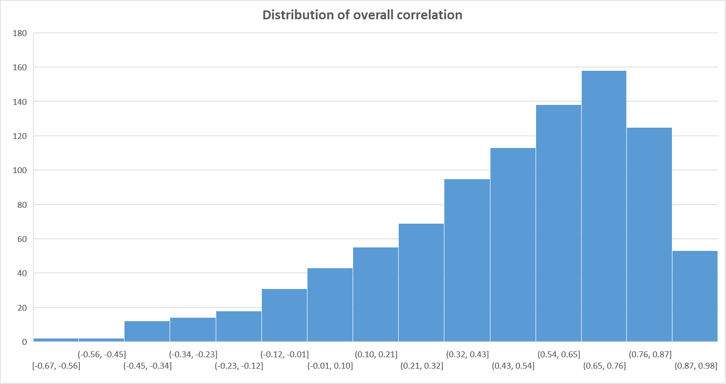
Pathway dynamic correlation
Notes:
I built this pharmacodynamics imaging system aiming to track drug response. This system has two key components – a collection of translocation reporters which shuffle between cytoplasm and nucleus based on drug activity, and a fully automated cell imaging system that can continuously scan the entire 96 well plate for days. Each well here contain a unique cell samples, they can be cells expressing different HER2 mutations or resistant gene drivers, or they can be cells under different treatments.
To facilitate data analysis, we also developed a customized algorithm to transform terabytes of images into analyzable figures for further interpretation.

Slide 14
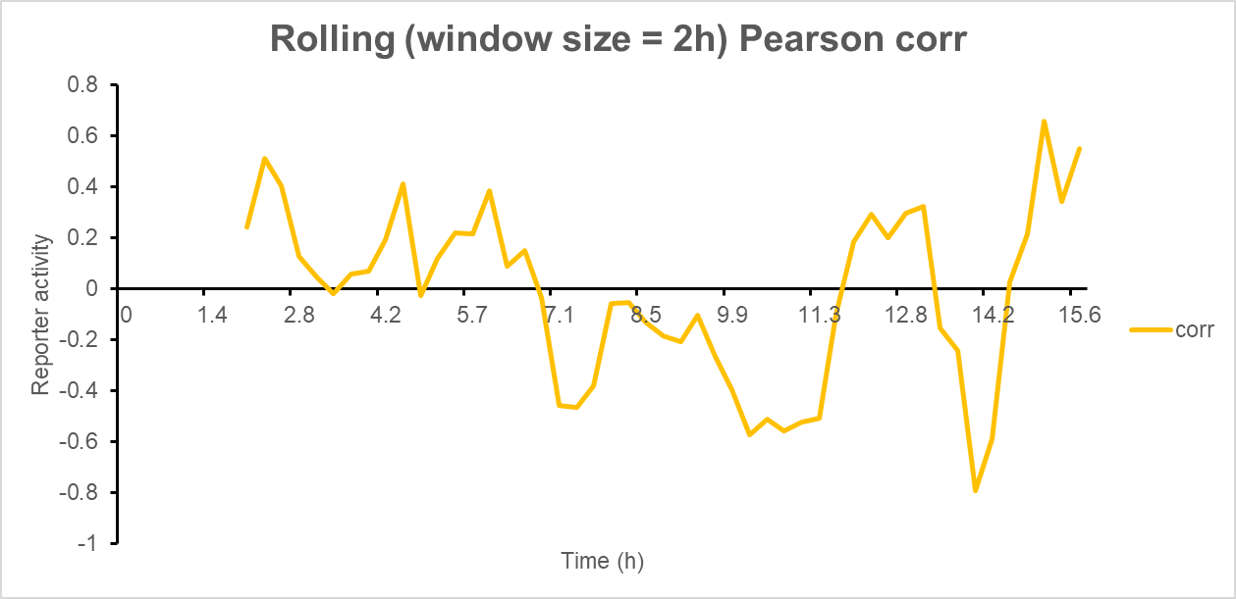
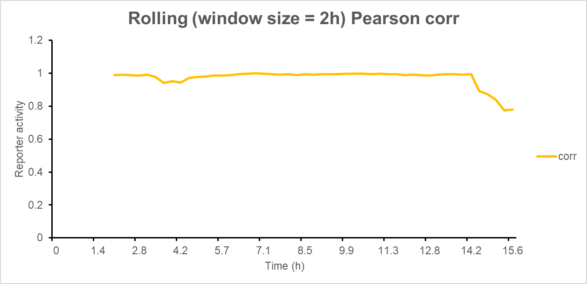
Rolling window correlation
Notes:
I built this pharmacodynamics imaging system aiming to track drug response. This system has two key components – a collection of translocation reporters which shuffle between cytoplasm and nucleus based on drug activity, and a fully automated cell imaging system that can continuously scan the entire 96 well plate for days. Each well here contain a unique cell samples, they can be cells expressing different HER2 mutations or resistant gene drivers, or they can be cells under different treatments.
To facilitate data analysis, we also developed a customized algorithm to transform terabytes of images into analyzable figures for further interpretation.

Slide 15
Time lagged Pearson correlation
Time lagged cross correlation (TLCC) can identify directionality between two signals such as a leader-follower relationship
Reporter dynamics
Cross-correlation
Offset between Red & Blue (frames)
Reporter 1 lead < 0 < reporter 2 lead
Notes:
I built this pharmacodynamics imaging system aiming to track drug response. This system has two key components – a collection of translocation reporters which shuffle between cytoplasm and nucleus based on drug activity, and a fully automated cell imaging system that can continuously scan the entire 96 well plate for days. Each well here contain a unique cell samples, they can be cells expressing different HER2 mutations or resistant gene drivers, or they can be cells under different treatments.
To facilitate data analysis, we also developed a customized algorithm to transform terabytes of images into analyzable figures for further interpretation.

Slide 16
More to do…
Test algorithms:
Dynamic time wrap + hierarchical clustering (better clustering method?)
Timeserieskmeans (https://tslearn.readthedocs.io/en/stable/gen_modules/clustering/tslearn.clustering.TimeSeriesKMeans.html)
Clustering based on multiple pathways?
Pipeline optimization:
FIJI ImageJ (java-based macro) – get slows after run
Python code optimization:
Check & clean-up my codes
Introduce quality check steps & output check results?
Combine scripts

